Slide 1

Empowering the Nation
Website and Mobile App Development

Slide 2
Introduction
The app is designed to increase the reach of the SME, provide better access to courses, and simplify communication between users and the SME.
The app is also designed to streamline services offered by "Empowering the Nation," focusing on training for domestic workers and gardeners.

Slide 3
Website Overview
The website offers an easy-to-navigate platform for users to learn about courses, check pricing, and contact the SME.
Key Features:
Course listings with detailed descriptions.
A fee calculator that includes discounts and VAT.
A contact form with map integration.
Design Approach:
Clean, professional design with easy-to-use navigation.
Responsive design to ensure accessibility on both desktop and mobile browsers.

Slide 4
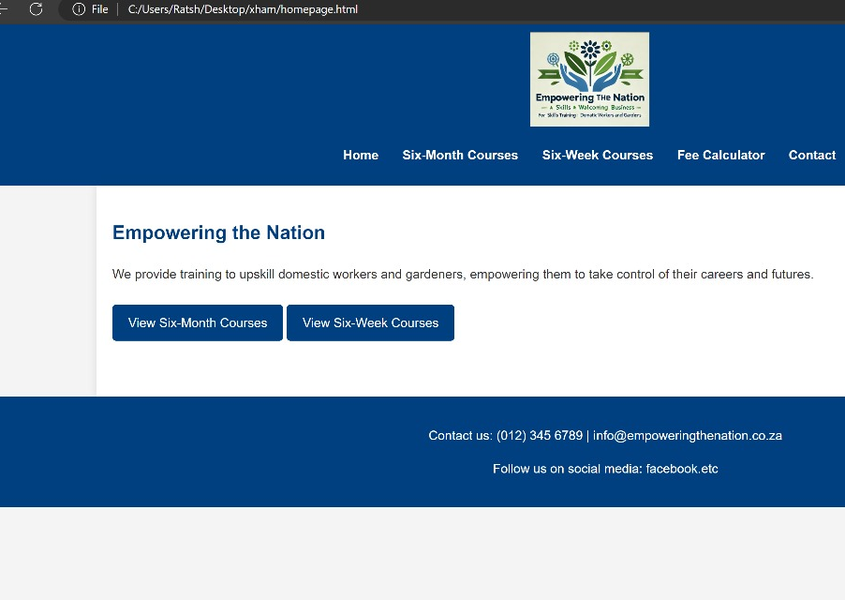
Website Home Page
Purpose: Serves as the entry point where users can easily access key information.
Features:
A clean, welcoming hero section with the SME’s mission.
Quick links to Courses, Fee Calculator, and Contact Us.
Design Decisions:
Large call-to-action buttons for "View Courses" and "Calculate Fees."
A footer with social media links and important information.

Slide 5
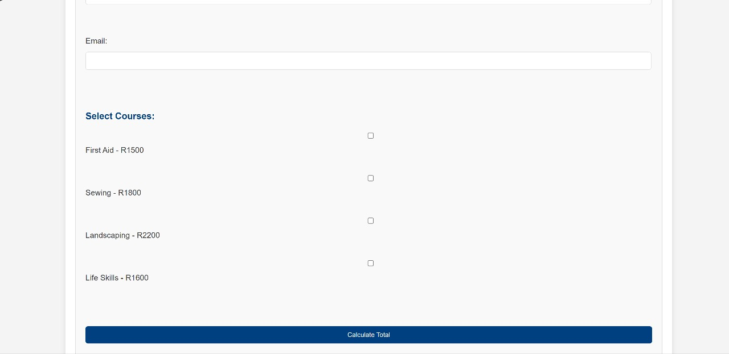
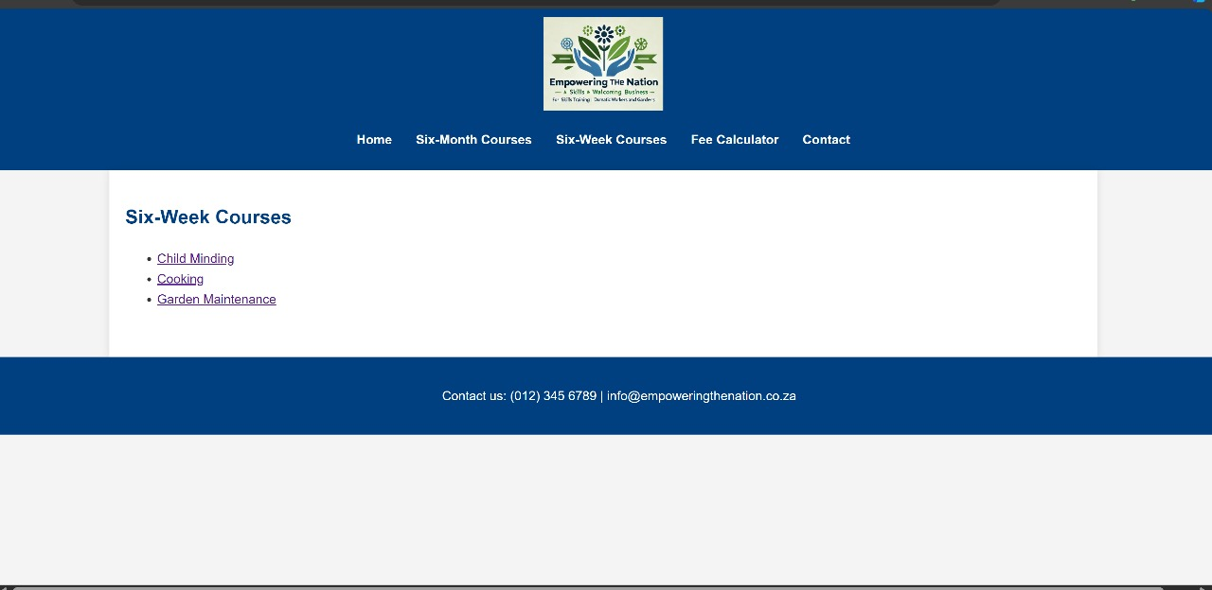
Website Courses Page
.
Purpose: Displays the courses offered by the SME with descriptions and pricing.
Features:
Each course is presented as a card with course name, duration, description, and price.
Filters for course duration (6-month or 6-week) to help users find what they’re looking for.
Design Decisions:
Simple, clean design with easy-to-read text.
Hover effects on course cards to enhance user interaction.

Slide 6
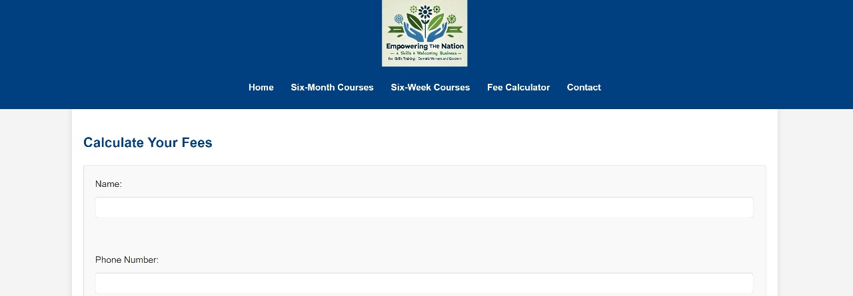
Website Fee Calculator
Fee Calculator:
Purpose: Allows users to select courses and view total costs, including discounts and VAT.
Features: Real-time fee updates based on the number of courses selected.

Slide 7
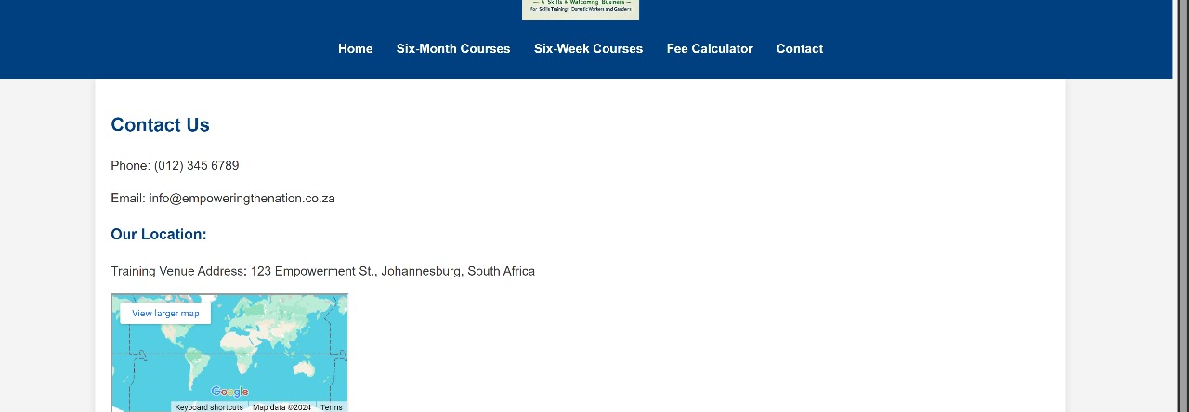
Contact Page
Purpose: Provides users with contact information, including an inquiry form and an embedded Google Map for location.
Features: Simple form with fields for name, email, and message.

Slide 8
Website Wire-Frame Link
https://www.figma.com/design/9aWv4WqjFhpZZKv8AWi9A0/Untitled?node-id=1-59&node-type=frame&t=8rDj34KeG0sxuTuZ-0

Slide 9

Mobile App Overview
Provide a seamless, on-the-go experience for users to access courses, calculate fees, and contact the SME.
Key Features:
Access to courses and fee calculation.
Contact form and map integration for venue locations.
Technology Stack:
Front-end: Flutter for cross-platform development (Android/iOS).
Back-end: Firebase for real-time updates and notifications.
Database: Firebase or MongoDB.

Slide 10

Mobile App Home Screen
Serves as a clean gateway for users to access courses, calculate fees, and contact the SME.
Features:
Large buttons for easy navigation to different sections.
Footer with icons for Home, Courses, and Contact.
Design Decisions:
Focus on simplicity and ease of use for quick access to features.
Visuals: Show a mockup of the Home screen, emphasizing its clean and intuitive design.

Slide 11
Mobile App Course Screen
Displays available courses in a scannable, card-based format.
Features:
Vertical scrolling to browse multiple courses.
Course cards containing title, price, and brief description.
Design Considerations:
Simple, visual layout with a focus on readability and ease of use.

Slide 12

Mobile App Fee Calculator and Contact Screen
Allows users to dynamically calculate the total cost of selected courses, applying discounts and VAT in real time.
Contact Screen:
Purpose: Provides users with a simple form to reach out and view venue locations.
Visuals: Show mockups of the Fee Calculator and Contact screen, demonstrating their functionality and user-friendly design.

Slide 13
Mobile Application Wireframe Link
https://www.figma.com/design/GBvMZL7cpcalx9MVS6EpEO/Untitled?node-id=1-15&node-type=instance&t=6QD9pNcJ6lJeFR4L-0

Slide 14
Conclusion
In conclusion, our design delivers a seamless, user-friendly experience that helps 'Empowering the Nation' promote their courses and engage with customers more effectively. We’re confident that this platform will assist in their mission to upskill the community.

